Slide 1
An Introduction to AllStarLink
Max Schneider, KE8DON

Slide 2
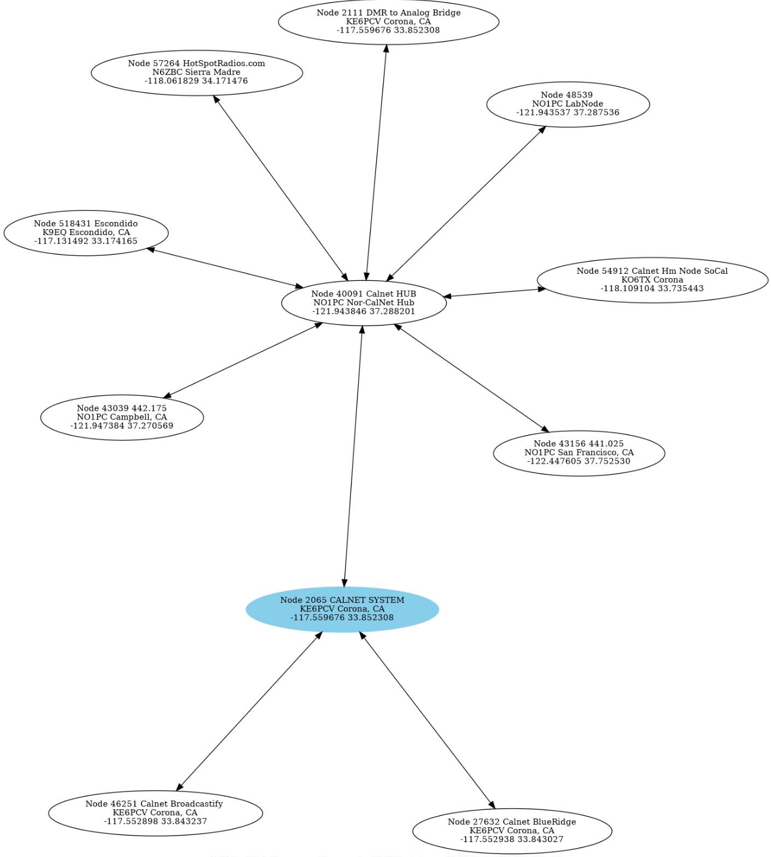
What is AllStarLink?
A network of repeaters, remote base stations, and hot spots accessible via Voice over Internet Protocol (VOIP)
Underlying components
asterisk and app_rpt (node communication)
asl-menu (configuration of node to AllStarLink)
Allmon3 (connection management)
Not for the faint of heart

Slide 3
From AllStarLink About Page
Once again, this technology is not intended to be implemented by the end-user or those light at heart. It takes serious commitment and resources (that which is required to put a radio system on the air to begin with, and to maintain it) by either a group, club, or maybe even a single, dedicated, talented (not to mention monied) individual. The assumption made with AllStarLink is that the purpose of this work and level of dedication is to share the goodness and great benefits with others, and to promote continuation of doing so.

Slide 4
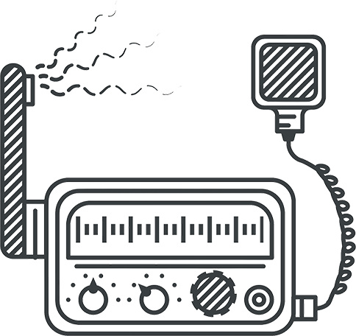
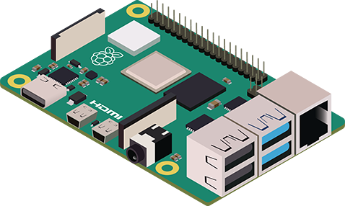
AllStarLink Architecture
INTERNET

Slide 5
Requirements for a Node
Linux system
Raspberry Pi 3, 4, 5
PC (currently only x86 or amd architecture)
2M or 70cm radio capable of supporting the interface (see below)
Appropriate interface: www.repeater-builder.com/products/usb-rim-lite.html
A Node ID registered at: www.allstarlink.org

Slide 6
Building the Node
Detailed instructions are available at allstarlink.github.io/user-guide/pi-detailed
Install Raspberry Pi Imager: www.raspberrypi.com/software
Get the latest image: repo.allstarlink.org/images/pi
Create the image on a micro-SD card (4GB minimum, 8GB recommended)
Insert the micro-SD, connect everything, and fire it up
Point your browser at <your new node>.local

Slide 7
Configure the Node
Node type: Hotspot
Call sign, node ID, and password from AllStarLink
Radio interface type: SimpleUSB
Tune the interface to optimize transmit/receive
Restart asterisk

