Slide 1
RF Exposure Calculations
Now Required for all Amateur Radio Transmitting Stations
As explained by Greg Lapin, N8PL, QST, May 2023, pg 64.
The ARRL has a lot of very useful information to help you.
http://www.arrl.org/rf-exposure
https://www.youtube.com/watch?v=7dSieKF3rm0

Slide 2
FCC RF Safety Rule Making History
1996 First FCC RF Safety Rule Affecting Amateur Radio
1998 First Rule takes effect but most stations exempted
2020 FCC Proposed new rules removing exemptions
2021 New Rules take effect but Hams get two year grace period to comply
May 3, 2023 All stations must be in compliance with assessment requirements.

Slide 3
Why This Rule and What is Required?
RF Energy results in the heating of biological tissues. At high enough levels the body may not be able to dissipate this heat causing injury.
You must ensure that unsuspecting individuals are not exposed to RF energy above a certain threshold.
Step 1. Calculate Minimum Safe Distance from Antenna (function of frequency and ERP)
Step 2. Document Calculations
Step 3. Mitigate any opportunity for exposure above the Maximum Permissible Exposure (MPE) level.

Slide 4
Categories of Exposure
Exposure limits are different depending on whom is being exposed.
Controlled Exposure
Occupational exposure and amateur radio operators and family who have been trained in RF Exposure.
Uncontrolled Exposure
Everyone else. (More Restrictive)

Slide 5
How to do the Calculations! The Hard Way.
You need to calculate the distance from your antenna at which the RF field strength for a given frequency drops below the MPE level.
What is needed?
Frequency (Band is close enough)
Transmitter Power
Feedline loss
Antenna gain as a function of direction
Antenna Height
Antenna Modelling Program – Gain as a Function of Direction

Slide 6
How to do the Calculations The Hard Way.
You need to calculate the distance from your antenna at which the field strength for a given frequency drops below the MPE level.
What is needed?
Frequency (Band is close enough)
Transmitter Power
Feedline loss
Antenna gain as a function of direction
Antenna Height
Antenna Modelling Program – Gain as a function of direction
It is a genuine PITA.

Slide 7
The Easy Way – Do this first – Worst Case
ARRL Online Calculator
https://www.youtube.com/watch?v=G3K7c8tb4OM
What does it do?
Calculates the Minimum Safe Distance from the antenna.
Inputs
Power at the antenna (transmitter output power – feedline losses)
Antenna Gain (dBi)
Mode Duty Cycle
Transmit Duty Cycle
Frequency

Slide 8
The Easy Way – Do this first
ARRL Online Calculator
What does it do?
Calculates the Minimum Safe Distance from the antenna.
Outputs
Maximum Allowed Power Density (mW/cm²)
Minimum Safe Distance (feet and meters)

Slide 9
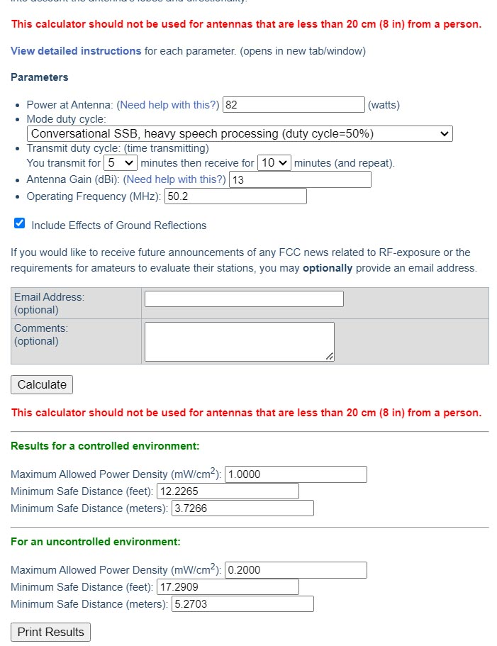
http://www.arrl.org/
rf-exposure-calculator

Slide 11
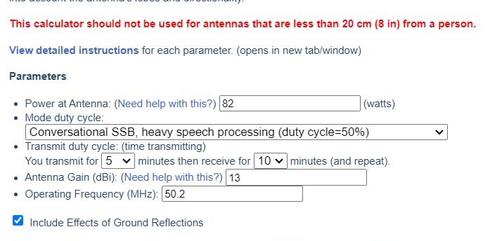

Slide 12
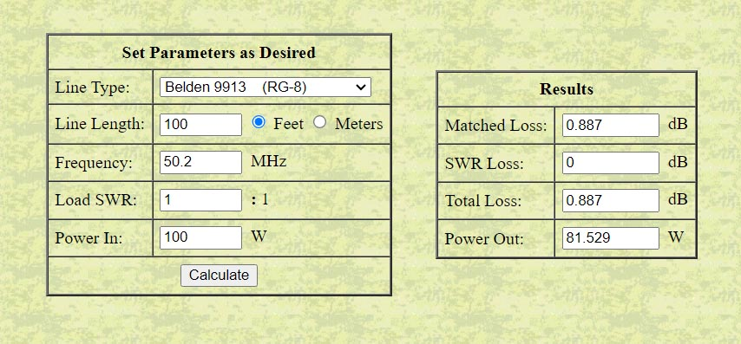
Coax Line Loss Calculator https://www.qsl.net/co8tw/Coax_Calculator.htm

Slide 13
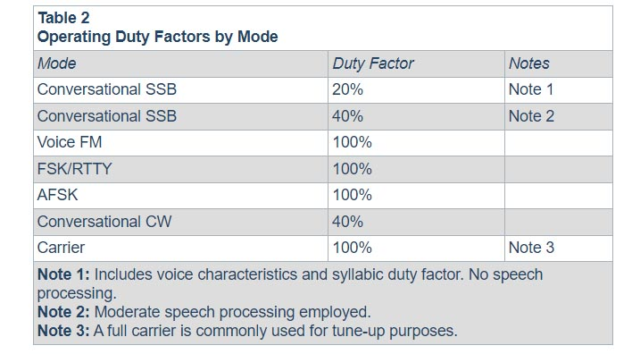

Slide 14
Typical Antenna Gain Values
Antenna Type | Approx. Gain (dBi) *
Half wave dipole | 2.15 dBi
10 element Yagi | 15.1 dBi
2 element Yagi | 5.9 dBi
3 element Yagi | 8.1 dBi
4 element Yagi | 9.1 dBi
5 element Yagi | 10.1 dBi
6 element Yagi | 11.1 dBi
8 element Yagi | 13.1 dBi
Delta Loop | 5.2 dBi
Four Square | 5.2 dBi
G5RV | 1.0 dBi
Hex Beam | 5.0 dBi
Moxon | 6.0 dBi
Quarter Wave Vertical | 1.5 dBi
Windom (OCD) | 2.0 dBi

Slide 15
Web links
Coax RF Loss Calculator
https://www.qsl.net/co8tw/Coax_Calculator.htm
ARRL RF Exposure Calculator
http://www.arrl.org/rf-exposure-calculator
ARRL RF Exposure Resource Page
http://www.arrl.org/rf-exposure
ARRL RF Exposure Calculator Parameter Explanations
http://www.arrl.org/rf-exposure-calc-instructions#gain
YouTube Video
https://www.youtube.com/watch?v=G3K7c8tb4OM

Slide 16
Let’s Do Some Real Calculations
http://www.arrl.org/rf-exposure-calculator

