Slide 1
Standing Wave Ratio
Paul Morabito
11-06-2025

Slide 2
SWR – Standing Wave Ratio
Seems to be a relentless drive to achieve the most coveted 1:1 SWR Ratio
Often on the air hear operators discuss, compare and brag about the efforts they went through to achieve a low SWR
Not the most important measurement of an Antenna’s performance but easiest measurement to make. Does not indicate how well an antenna radiates electromagnetic energy instead how much of the power offered to the antenna is reflected back to the load
What is SWR what makes it bad and when to worry about it?

Slide 3
What is SWR
Sometimes called VSWR – Voltage standing wave ratio
When Keying a transmitter an RF voltage develops on the transmission line
Forward Wave – voltage travels down the feed line to the antenna
Reflected Wave – in some cases the wave is reflected back because of impedance mismatch at the load
SWR is a measure of what is happening to the forward and reverse voltage waveforms and how they compare in size

Slide 4
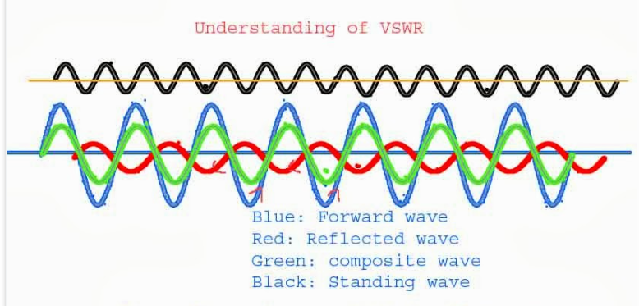
Figure of Waveforms for a Mismatched System
A standing wave in a transmission line isn't a single, real, propagating wave but rather the result of the interference pattern created by two real waves moving in opposite directions. An incident wave reflects from an impedance mismatch at the load, creating a reflected wave that interferes with the incident wave, forming a stationary pattern of nodes and antinodes. These real, traveling waves of voltage and current cause the standing wave phenomenon

Slide 5
Prolong Transmission at High SWR
Can damage a transmitter's final amplifier stages due to reflected power, leading to overheating and complete burnout
High voltages and currents from the reflected power can damage the internal components of the radio, while excessive heat can melt insulation and destroy semiconductors
Most modern transmitters have protection circuits to reduce output power or shut down when SWR is too high, but sustained operation can still shorten the radio's lifespan
Do you know what your radio will do when it encounters high prolong SWR?
Icom IC-7300 – Will not turn off - Lowers power – enters Emergency mode to handle 10:1
Icom IC-9700 – Will shut down

Slide 6
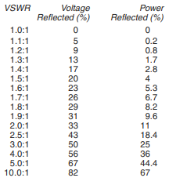
SWR vs % Voltage Reflected
Example #1
50 ohm coax (assume no loss) and 50 ohm antenna Impedance
Matched condition SWR 1:1
All energy transferred to antenna to be radiated
Same voltage exists anywhere along the coax
Example#2
50 ohm coax (assume no loss) and 100 ohm antenna Impedance
Mismatched condition SWR 2:1
As you move along the coax length the voltage changes
as it now has peaks and valleys
33 % of voltage wave is reflected and eithers add
to and subtracts from the forward voltage wave
Since the voltage along the line changes with position and is different from what the transmitter would produce a Standing Wave occurs
“All Power will eventually gets radiated”

Slide 7
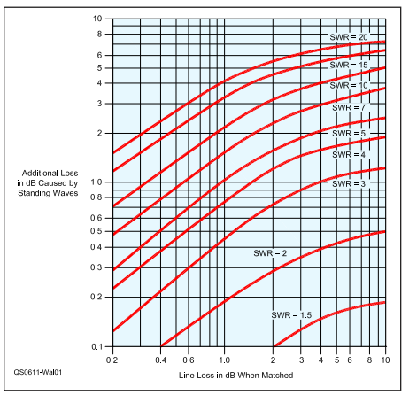
What about Line Loss
Transmitting 1 Watt of Power
SWR | Cable Loss | MisMatch Loss | Power Applied to Antenna
1:1 | 3dB | 0.00 dB | 0.50 W
2:1 | 3dB | 0.35 dB | 0.46 W
3:1 | 3dB | 0.90 dB | 0.41 W
Link: Coax Loss Calculator

Slide 8
Feed line Lifetime
Factors affecting cable lifetime
Cable quality: Higher-quality cables with better UV-resistant jackets, like LMR-200 or LMR-400, are designed for longer outdoor life.
Installation environment: Cables exposed to harsh UV radiation, moisture, and extreme temperatures will degrade faster.
Physical damage: Sharp bends, kinks, or other physical damage can shorten the cable's lifespan.
Signal frequency: Higher frequencies are more susceptible to signal loss, and a cable's performance can degrade over time, making it important to monitor SWR.
How to tell if your cable needs replacing
Visual inspection: Look for cracking in the insulation, corrosion on the connectors, or other signs of physical damage.
Performance testing: Check for an increase in signal loss or a change in characteristic impedance using an SWR meter into a dummy load.
SWR/loss test: If the cable passes visual inspection and the SWR and loss tests are within acceptable limits, it can often be reused.

Slide 9
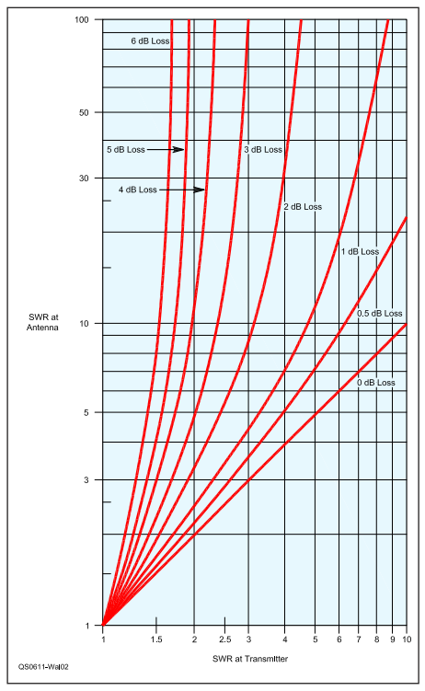
SWR Readings at Transmitter can be Misleading
Example: New 2 meter Antenna and feed it with 120 feet of RG-8X cable (4.5 dB loss)
Measure SWR at Transmitter as 2:1
According to graph SWR at Antenna is Actually 20:1(7 dB loss) NOT 2:1
Total loss of 11.5 dB – Less than 1/10 of your transmitter power is being radiated.
Cable loss attenuates Reflective Power giving false SWR readings
“Always measure SWR at Antenna”

Slide 10
Ladder Line Works for High SWR
Been used since early days of Radio
Loss is quite low at HF frequencies
300 Feet of 450 ohm has a loss of 0.5 dB at 30 MHz where as high end Coax will be 1-2 dB loss
Low loss because of air dielectric – allows most of the reflections to radiate instead of being lost within the cable

Slide 11
Ladder Line Example for High SWR
Example – Installed New Full Wave HF dipole
Feed it with 300 Feet of 450 ohm Ladder line with line loss of 0.5 dB at 30 MHz
You happen to know Antenna impedance is 4500 ohms; “SWR 10:1”
Recall Graph additional loss of 1.4 dB at 10:1 SWR
Overall 1.9 dB loss – Toss in a tuner and you are Good to Go!
Your Friend with same exact radio, tuner and Antenna using 40 feet of 50 ohm coax with 0.25 dB loss. He uses a turner to satisfy his radio but His SWR is 90:1 with mismatch loss of 12 dB.

